Slide 1
Group 5
Fraud detection – develop a machine learning model to check for fraud and other suspicious activity.
Delivered by:
Hannah Mitchell
Toby Girvan
Zoë Howe
Notes:
Good afternoon everyone,
We are group 5,
My name is Hannah and I’m from a fraud background, also presenting is
Toby, a Team manager from Needs met and
Zoë, from a branch background
We chose to tackle the challenge around developing a machine learning model to detect for fraud and other suspicious activity.

Slide 2
Introduction
Agenda:
The way in which the problem was approached
Iterative model development and evaluation
Planned deployment architecture
Final thoughts/Conclusions
Notes:
We are looking at covering:
How we approached the problem, the brainstorming and research involved.
Sourcing and Investigation of the dataset we used
Our Model Development
Model Deployment
Our conclusions and findings that we uncovered as part of this project.

Slide 3
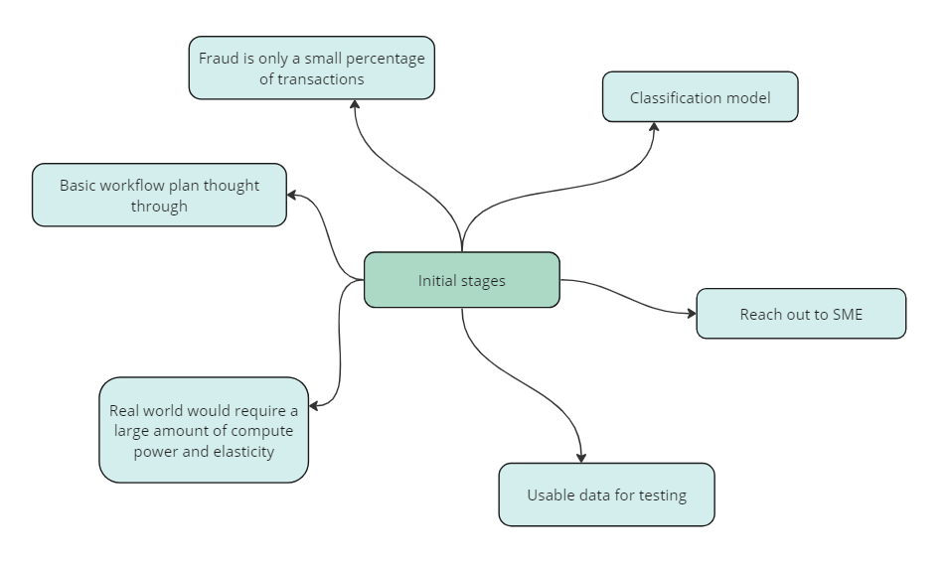
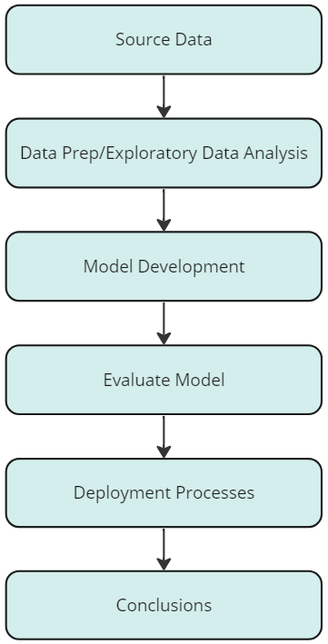
Brainstorming
Notes:
So on your screen you can see our initial thoughts displayed in a mind map:
Off the back of our brainstorming we had 3 main considerations:
In general due to the nature of fraud any dataset we use is likely to be imbalanced, so how will we deal with this?
Where will we find usable data?
And what systems will be best to use?
You can see on the right side of the slide our initial process flow we developed.
Change slide
Fraud is generally only a small percentage of transactions, so any dataset is likely to be heavily imbalanced and we will need to consider how will we address this in our model.
Our problem is a classification problem so we will therefore use a classification model to predict whether a transaction is fraud or not.
We wanted to contact Subject Matter Experts as we thought it would be beneficial to know the current processes that LBG has in place and challenges they faced.
For any real world implementation would require a large amount of compute power and elasticity. We need to consider what systems will be best to use for these requirements to complete analysis and create a working model.
Basic workflow plan, see the diagram on the right, this was our initial thought process on how we needed to approach this project.
Finding usable public data was a challenge, considered using synthetic data but we were concerned about time constraints.

Slide 4
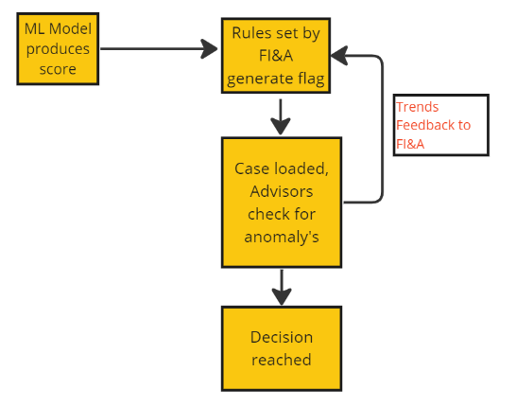
Main Insights
Engaged with SMEs in Fraud Labs, Fraud Intelligence & Analytics and Economic Crime
Key outputs:
Use of third party service provider Feedzai to support Fraud Operations
Facilitate cloud based storage & processing via AWS & integrate into current GUI’s
Flags are limited based on staff availability. This could lead to some instances of fraud slipping through.
Primary challenge is balancing between identifying fraud, limiting false positives all the while remaining within our capacity (staffing)
The new Payment Systems Regulator (PSR) requirements relating to APP fraud: both sending and receiving firms splitting the costs of reimbursement 50:50, potentially increasing costs for LBG.
Notes:
While researching we approached 3 colleagues from within different areas of LBG
The key outputs from those conversations were:
A third party provider Feedzai is used, they facilitate the production,deployment and customisation of our current fraud models currently held in AWS Cloud and these are combined with conditional rules set and reviewed by LBG.
Primary challenge is balancing the identification of fraud while limiting false positives and maintaining colleague capacity to address fraud alerts.
Also with the new Payment Systems Regulator requirements coming into effect this year this will mean that both the sending bank and receiving bank will be liable to reimburse customers 50:50 that are victim to APP fraud.
Increase capacity of colleagues to deal with the fraud alerts
Develop a model which is also capable of identifying sufficiently the beneficiaries of fraud.
You can see the diagram on the right represents the current process of fraud detection within LBG currently - change page
Transactional data is fed into the model that produces a risk score , we also then have another layer where rules are set by colleagues in our FI&A team based on trends found from reported cases. These rules can work independently and in conjunction with the model score to decide whether to stop a transaction. These cases are then addressed by customer facing fraud advisors.

Slide 5
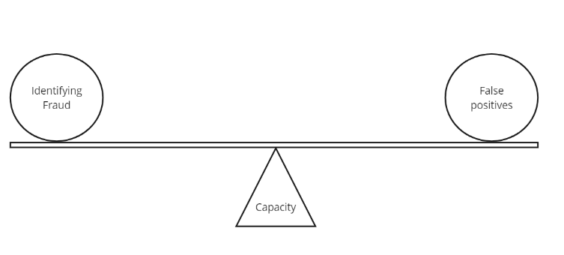
Challenge
Correctly identifying fraud, while limiting false positives
To do this we want to create a model that correctly increases the probability of capturing genuine fraud transactions v non-fraud/false positive fraud.
Increase efficiencies among staff by reducing the number of false positives meaning that colleagues will be working the customer flags that are genuine fraud
Reduce impact on customers, declining genuine transaction that leads to customer dissatisfaction.
Notes:
Correctly identifying fraud, while limiting false positives
To do this we want to create a model that correctly increases the probability of capturing true positives(actual fraud) v false positives (genuine transactions).
By doing this we will:
Increase efficiencies among staff by reducing the number of false positives meaning that colleagues will be working the alerts that are genuine fraud
Reduce customer dissatisfaction, by declining less genuine transactions.
I will now hand over to Toby and he will take you through how we sourced our data and our models.

Slide 6
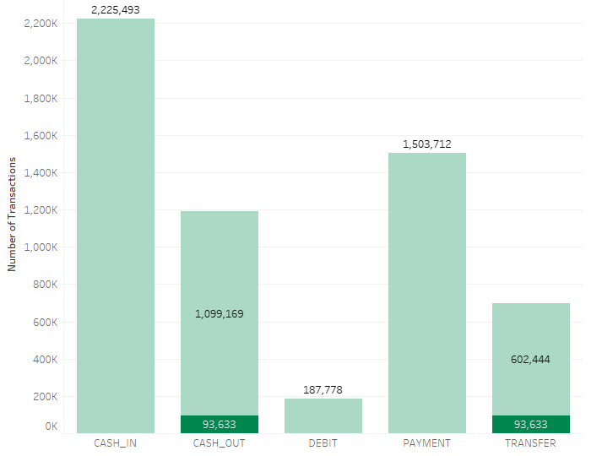
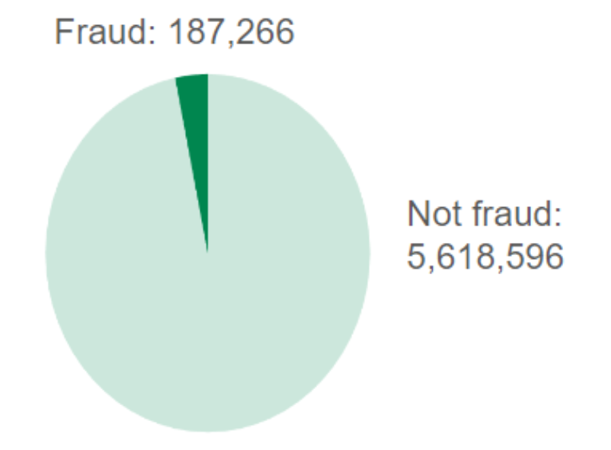
Sourcing Data:
Obtained from paysim mobile money simulator:
Based on sample of real world transactions extracted from one month of financial logs from a service provider
Includes redundant columns as all fraud located in cash_out & transfers
Imbalanced dataset and will require solution to address, gradient boosting, or over/under sampling.
5.8M Transactions
187K Fraudulent Transactions
Imbalanced classes
Notes:
We have identified objectives- First step obtain relevant data
Data sourced from Kaggle which comes from PaySim application
The data is based on sample of real world transactions extracted from one month of logs from financial service provider.
As you can see, out of 5.8M transactions 187K recorded as Fraud
Main Challenge:
This is a Imbalanced dataset-
However - This is the same problem that we would have with real world LBG data.
Knew this would require solutions to address, initial thoughts were to use methods such as gradient boosting, or over/under sampling.

Slide 7
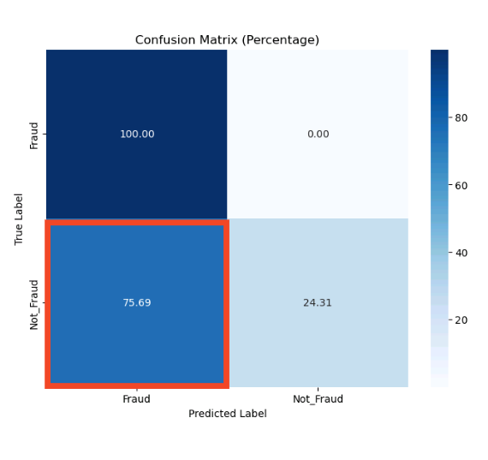
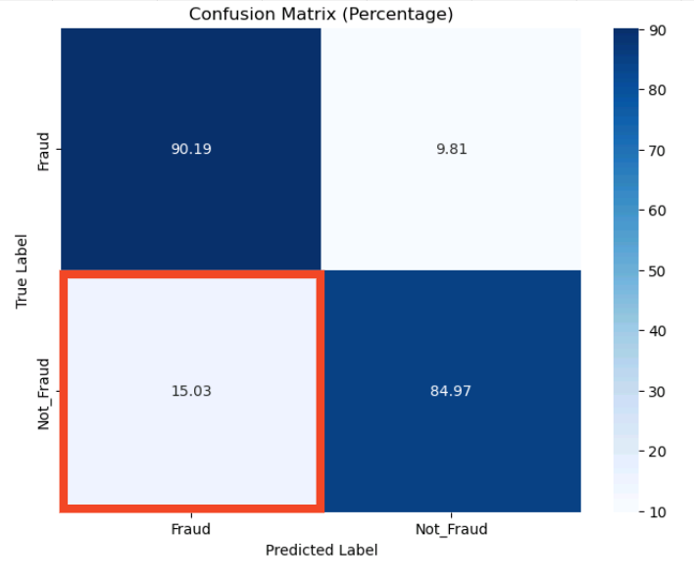
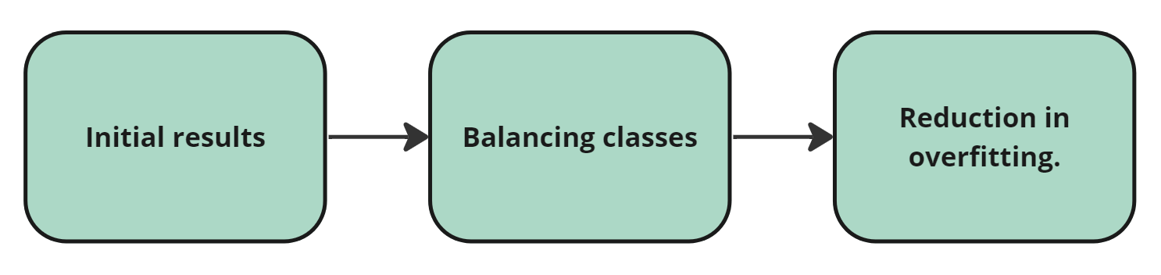
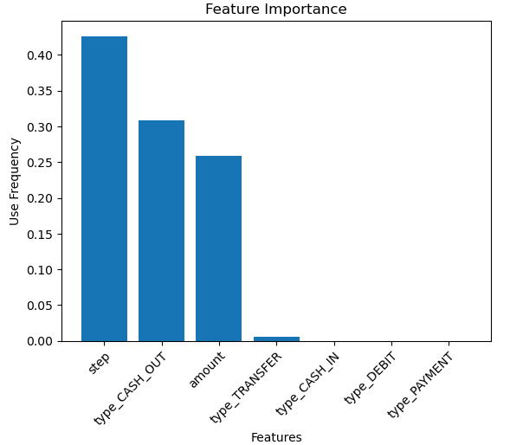
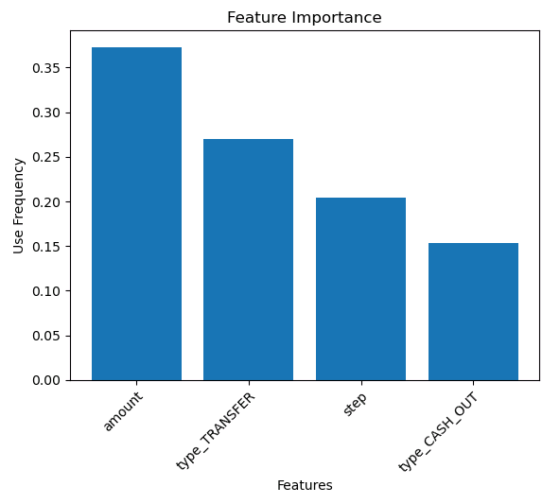
Decision Tree
Initial model biased towards fraud
Predicting 75% of genuine transactions as fraud. (false positives)
After initial balancing able to reduce this to 15%
Concluded we needed a different model which is better handling imbalance data
Notes:
This is our 1st Model - decision Tree, written in python
Although Knew that this model type would not be as capable of dealing with problems we had identified - its purpose was to give baseline for comparison
Looking left to right you can see initial model was biased towards predicting transactions fraudulent,
75% of genuine transactions fitting into this category
After balancing data using class weight function reduced this to 15%, also missed capturing 10% of fraudulent
Confirmed that we needed change to model capable of dealing with this problem

Slide 8
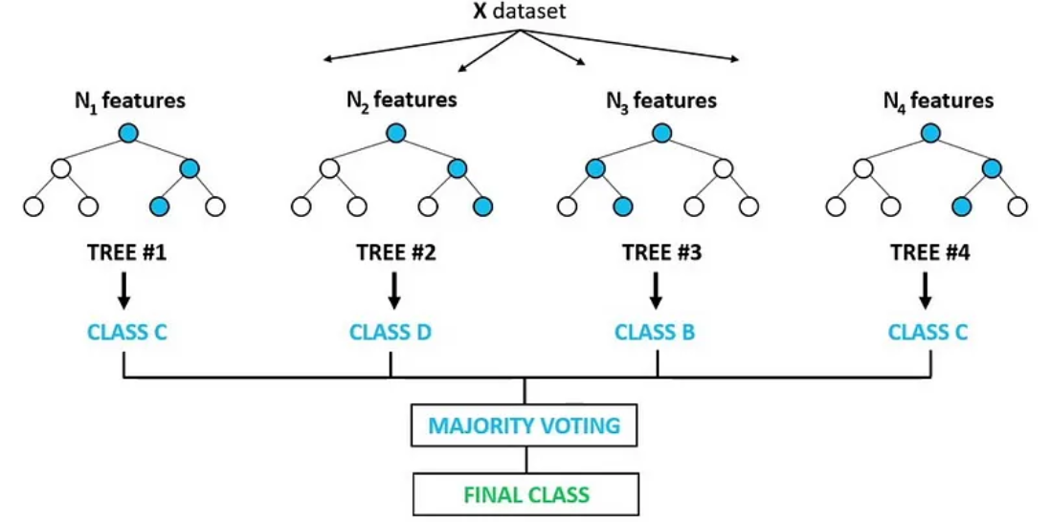
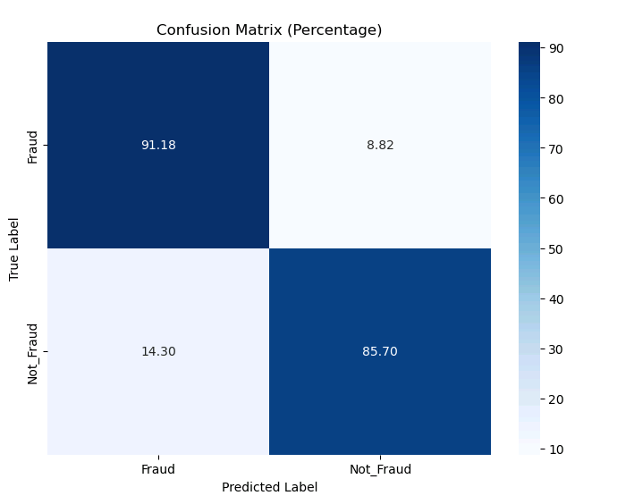
Random Forest- Classifier
Slight improvement using random forest model however not substantial
Significant train time, approx. 2 hours. This is not suitable if multiple iterations need to be completed.
Decided to move into Google Cloud as this offers increased compute power for training
Also take advantage of more complex models designed to further deal with imbalancing.
Notes:
Next Model- Random Forest
You can see a diagram representing what a random forest is doing
with each tree created with a random subset of features, reduces likelihood of overfitting
Slight improvement using random forest model however primary challenge was computing power, takes significantly longer to run compared to single tree.
Close to two hours for last iteration of model.
Following this
Decision taken at this stage to move onto cloud and take advantage of other model types & processing power.
Also took significant amount of time to run, 2 hours to train.
Random forests are better at predicting than decision trees because they use an ensemble of multiple decision trees, each trained on a different subset of the data and features. This reduces the variance and overfitting of the model, making it more robust and accurate on unseen data.
Random forests also provide an estimate of feature importance, which can help in feature selection and understanding the underlying data
Reduced overfitting, improved accuracy, robust to outliers, feature importance, handling missing values, stability and consistency

Slide 9
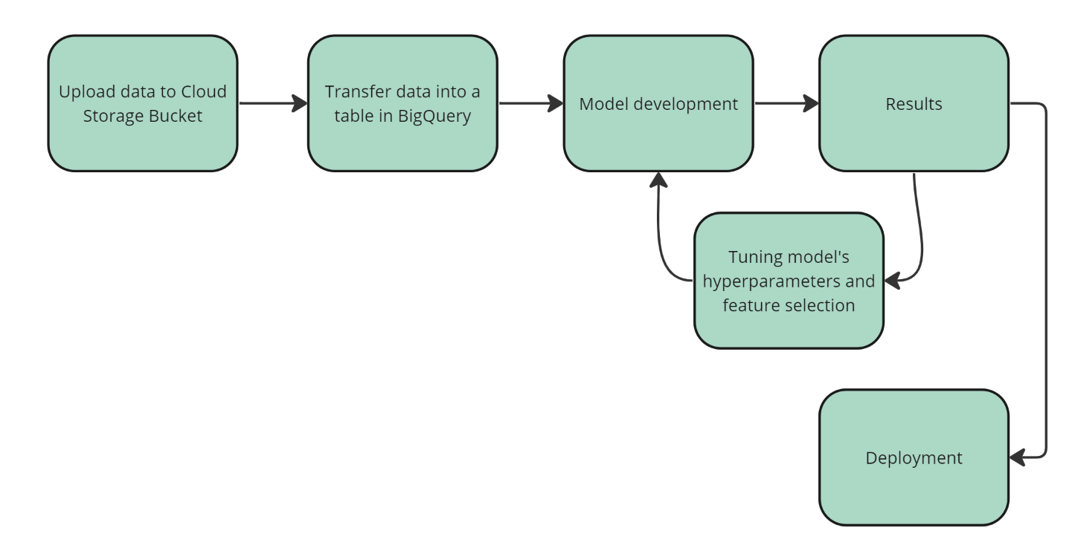
Move to Google Cloud
Notes:
This Slide, just to give a brief overview of the process of migrating this model to the cloud, model development and deployment.

Slide 10
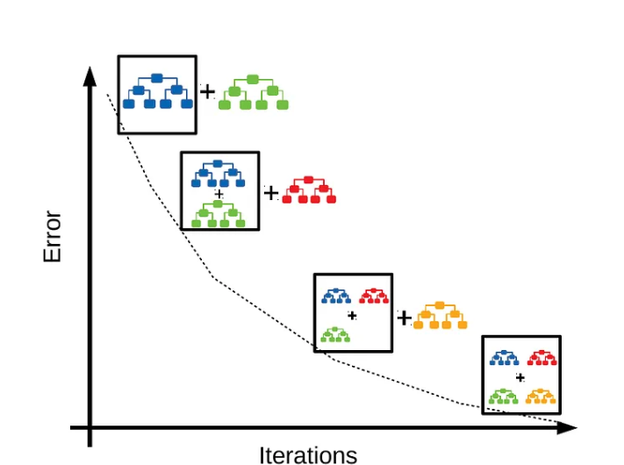
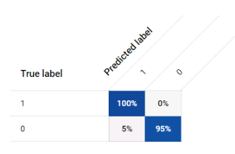
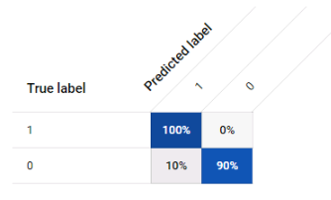
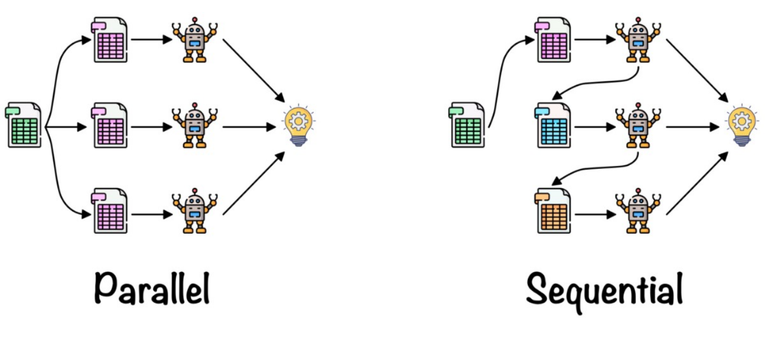
Google Cloud Result
XGBoosted Tree
Fraud
Not Fraud
Fraud
Not Fraud
XGBoosted
Random Forest
Fraud
Not Fraud
Fraud
Not Fraud
Notes:
We created 2 different types of models in BQML
Boosted Tree
Random Forest
Both use Xtreme Gradient Boosting or XGBoost -
In summary, the key difference lies in the way trees are constructed.
XGBoosted Trees are built sequentially with a focus on correcting errors made by the previous trees,
XGBoosted Random Forest builds multiple trees independently in parallel, introducing randomness through data and feature subset.
Both models also have functions for auto hyperparamatisation, finding the best combination of parameters for your target variable.
As you can see highlighted our Boosted Tree produced best results
Best result saw a significant decrease in out false positive percentage to 5%, while capturing 100% of transactions identified as fraudulent in out dataset
Haven't been able to make significant improvement beyond this, fundamentally down to the data quality and features available.
Our next step would be to source the extra data , create new aggregate features before continuing with the deployment, and Zoe will take you through that now
A boosted tree model starts with one decision tree, and then adds more trees one by one, each trying to fix the mistakes of the previous ones. A boosted tree model learns from its own errors, and tries to fit the data as closely as possible.
A boosted random forest also uses many decision trees, but it does not add them one by one. Instead, it creates all the trees at once, each using a different part of the data and a different set of questions. A boosted random forest does not learn from its own errors, but it uses the average of all the trees to make the final prediction.
Boosted random forest uses boosting, which means it trains the trees sequentially, each one trying to correct the errors of the previous ones. It does this by assigning higher weights to the misclassified instances and using a learning rate to control the contribution of each tree. This increases the accuracy and performance of the model, but it also makes it more prone to overfitting and sensitive to outliers
The main difference between a boosted tree model and a boosted random forest is that a boosted tree model tries to be very precise and accurate, while a boosted random forest tries to be very diverse and robust. A boosted tree model can make very good predictions, but it can also overfit the data, which means it does not work well on new data that it has not seen before. A boosted random forest can handle new data better, but it can also be less accurate, because it uses less information from each tree.
XGBoost has many features and advantages that make it popular among machine learning practitioners, such as:
It can handle various types of data, such as numerical, categorical, text, and image.
It can deal with missing values and imbalanced datasets by using different techniques, such as bootstrapping, subsampling, weighting, and stratified sampling.
It can provide an estimate of feature importance, which can help in feature selection and interpretation.
It can run on a single machine or a distributed system, using parallel and distributed computing.

Slide 11
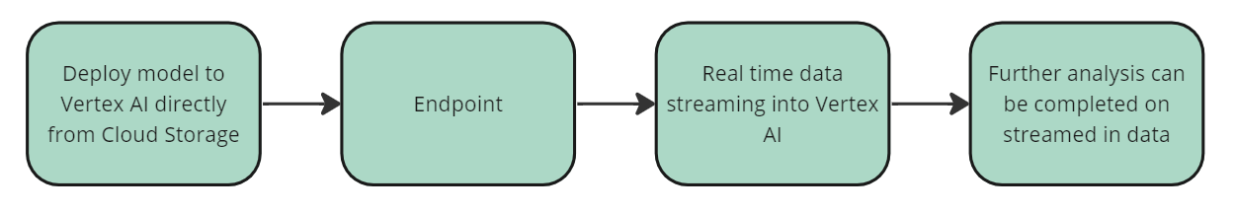
Planned Deployment Architecture
Notes:
Following the creation of the model we would look to deploy this within the cloud
We would deploy model directly to Vertex AI from Cloud Storage, this would allow live model monitoring to help evaluate if the model requires retraining
Once a model is trained, it is deployed as an Endpoint
So the endpoint is a distributed API management system and acts as a server that can receive data and return predictions based on what the model has learned
We would use real-time data streaming into Vertex AI using Google DataFlow, meaning we can process and analyse large sets of data with the possibility of scaling as required.
And using Looker, which is similar to Tableau or Power BI, we would be able to use more up to date results allowing useful insight visualisation and dashboard creation

Slide 12
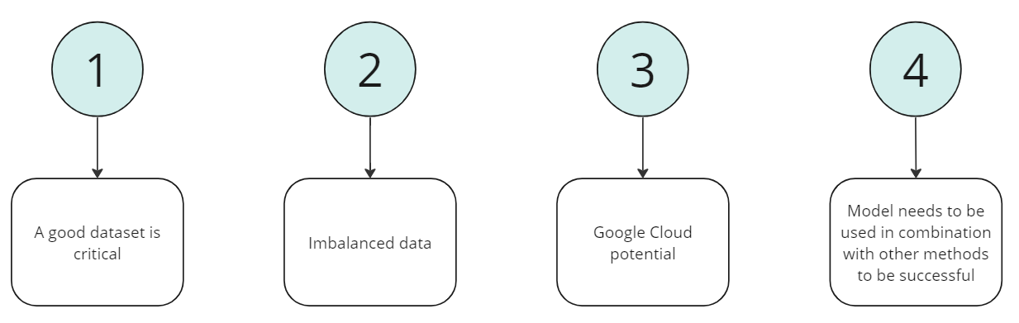
Conclusion
Notes:
In conclusion
A good dataset is critical, in a perfect world it would have been great to try and run a model on accurate sample data and analyse the results produced
The methods we used to deal with the imbalanced data have been effective, the over/under sampling and gradient boosting we used, achieved the results we expected. We reduced our initial decision tree from 75% false positive to 5% using the BQML model
Moving on to Google Cloud potential, the 3 main points for us were:
Number 1 being Processing power available - Faster at training the model and seeing results, so the model was built and viewable in approx. 6 mins compared to over an hour locally
Next would be Scalability - allowing easy scaling up or down based on requirements
And then Flexibility - Allows the choice of only the programs needed with pay-as-you go features for better cost efficiency with no on-premises maintenance costs
The model does needs to be combined with other methods already in place within Lloyds Banking Group to keep up with the ever evolving fraud trends this highlights the need for constant development and improvements
Thank you very much for listening, is there any questions?

Slide 13
References
Data Ingestion: - Dataset taken from Kaggle - https://www.kaggle.com/datasets/ealaxi/paysim1
Acknowledgements - This work is part of the research project ”Scalable resource-efficient systems for big data analytics” funded
by the Knowledge Foundation (grant: 20140032) in Sweden.
Please refer to this dataset using the following citations:
PaySim first paper of the simulator:
E. A. Lopez-Rojas , A. Elmir, and S. Axelsson. "PaySim: A financial mobile money simulator for fraud detection". In: The 28th European Modelling and Simulation Symposium-EMSS, Larnaca, Cyprus. 2016

